Slide 1

Zomato Restaurant Expansion Project
Created By
Badam Sai Abhigna
18-05-2025

Slide 2
Introduction and Objectives
Zomato is a leading Indian multinational in the food tech industry, operating a platform that connects customers, restaurants and delivery partners.
Zomato holds a significant market share in India’s food delivery industry with reports indicating around 58%.
This project explores a comprehensive dataset of Zomato restaurants worldwide.
The main objective is to identify the location where we can open new restaurant.

Slide 3

Data Overview
About Data
There are total 2 tables and 21 attributes in the data and after cleaning there are 9542 rows in the data.
Data cleaning and Preprocessing
Removed Duplicate Values.
Missing Values :- There are some missing values in cuisine column . Removed the rows having missing values
Fixed the format of Date column
Key Data Points
Some of the key attributes are Country, City, Cuisines, Rating, Price range, Average_cost_for_two, Datekey_Opening, Has_online_delievery(whether the restaurant has online delivery or not), Has_table_booking(has table booking option or not).
Data Importance
The data is helpful to do analysis trends in restaurant industry across all the countries , so that we can identify the potential location to open a new restaurant.
We can examine avg rating, count of restaurants, price range etc to identify potential location to open new restaurant

Slide 4


Methodology
01
Data Understanding :-
Did some review of the provided data sets to understand which columns are most important for our analysis.
02
Data Cleaning :- Remove duplicates using Remove Duplicates feature, removed the rows containing missing values and formatted the columns using Format feature and FIND and REPLACE
03
Data Preprocessing :- Used VLOOKUP to add additional columns, used YEAR and TEXT functions to extract year and month and used CONCAT ,MID, LEFT and RIGTH to combine cells
04
Descriptive Analysis :-
Employed pivot tables to for summarizing key metrics and analyzing the expansion for Zomato across different countries and cities.
05
Visualization :-
Created dynamic charts and dashboards for data representation and enabling interactive data exploration

Slide 5
Number of Restaurants in each Country
India has the most no of restaurants opened around 8652 restaurants which is 90% of total restaurants and next USA which has 425 which is only 4%.
Least no of restaurants in Canada.

Slide 6
No of Restaurants opened in year 2010-2018
There is increment in year 2011 but there is big drop in year 2012 and next 2 years there is good no of restaurants opened but again there is a drop in year 2015 and 2016 and there is good increment in year 2017 and 2018.
In 2012,2015 and 2016 least no of restaurants are opened.
From 2016 there is significant growth in no of restaurants this insight gives that the restaurants count may increase in coming year

Slide 7
Average number of votes for a restaurant in each Country
The average votes is high in country Indonesia followed by UAE, USA and Turkey
Brazil and Singapore has least voters.
Even having highest no of restaurants, the average voters in India is low.

Slide 8
Suggested Countries for opening new Restaurants
My suggested country for opening new restaurant is a country where the restaurant market is saturated very low and rating is high
Less number of restaurants means there is good chance we can develop our market there.
High Rating means the customers are satisfied by the service of the restaurants there and they are willing to eat outside.

Slide 9
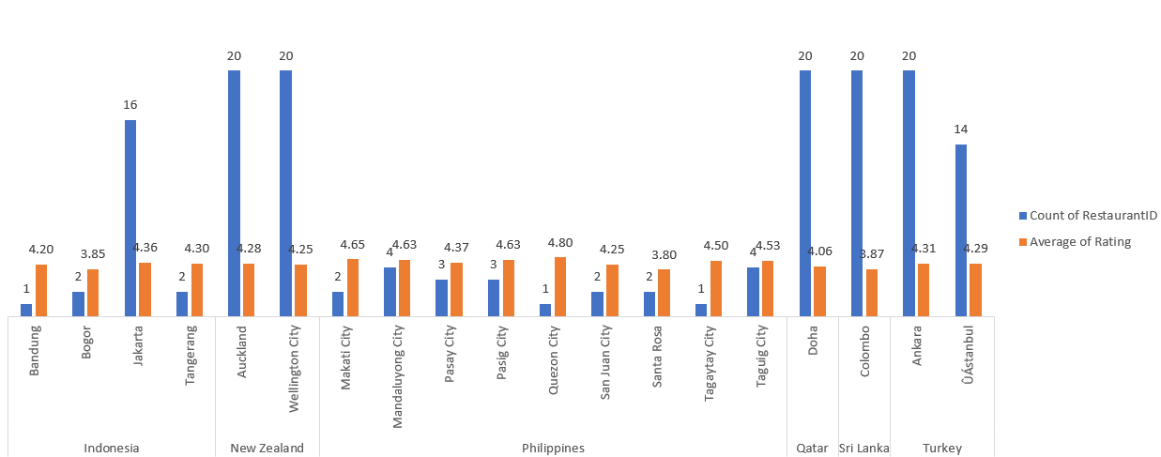
Which City in a Country?
The high average rated cities and their count of Restaurants of Suggested Countries

Slide 10
Cuisine Suggestions
List of top Cuisines of Suggested Countries
Indonesia : Indonesian, Japanese, Western
New Zealand : American, Italian
Philippines : Filipino, Japanese, and seafood
Qatar : Chinese, Thai, Indian
Turkey : Turkish, Turkish Pizza
Sri Lanka : Seafood, American

Slide 11
Price Suggestion
From chart we can see that the maximum no of restaurants around 46% belongs to price range 1.
This indicates that the greater the number of Restaurants concentrate on keeping their price range low to attract more no of customers.

Slide 12
Additional Services
Very less percentage of Restaurants are providing online delivery and table booking service
The restaurants that provide both services are high average rating
So, the best suggestion is to provide both services for new restaurants
Has_Online_Delivery | Average Rating
No | 2.75
Yes | 3.29
Has_table_booking | Average Rating
No | 2.81
Yes | 3.48

Slide 13

Strategic Recommendations
Low Restaurant Density
Identify countries with a lower number of restaurants compared to others, as this suggests less competition and potentially greater opportunities for market share.
High Rated Restaurants The data indicates that customers in the suggested countries are generally more satisfied with restaurants, highlighting a potential market opportunity for your specific cuisine or concept
High Rated Cuisine
Identify the high rated cuisines in that country/city for customer attraction.
Price Range
Minimum Price Range attract a greater number of customers.
Additional Services:
Providing online delivery and Table booking is a good service and can increases revenue and rating.

Slide 14
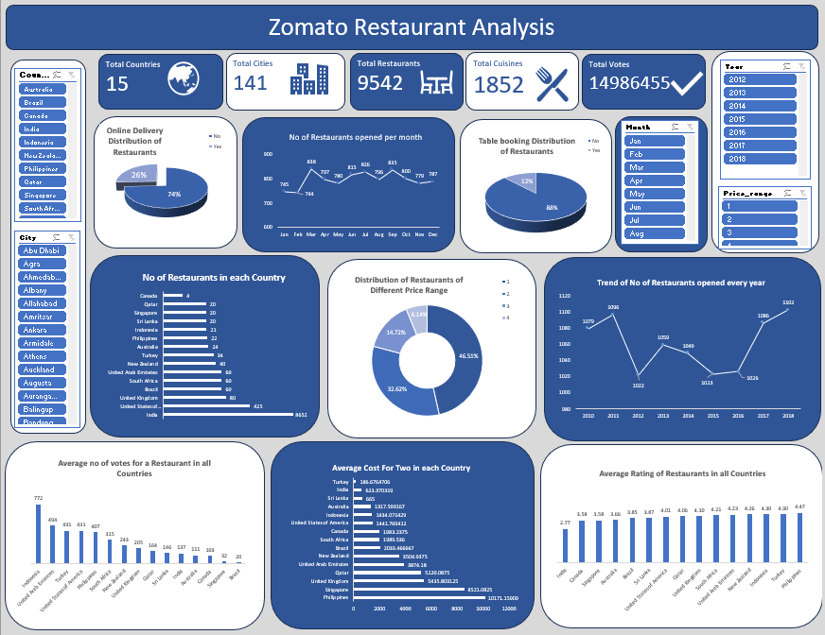

Slide 15
Conclusion
Our analysis of restaurant data has revealed significant opportunities for global expansion.
By focusing on countries with high average ratings and lower restaurant density, we can strategically position ourselves in markets with less competition.
This data-driven strategy allows us to make informed decisions that enhance our chances of success, ensuring effective restaurant placement and the potential for a thriving global presence.

Slide 16

References
Data Provided by Team.
Software Used :-
MS Excel
MS Word
MS PowerPoint

